Slide 1
CIS 700-004: Lecture 1W
History of Deep Learning
1/16/19

Slide 2
Syllabus Stuff

Slide 3
Key questions in this course
How do we decide which problems to tackle with deep learning?
Given a problem setting, how do we determine what model is best?
What’s the best way to implement said model?
How can we best visualize, explain, and justify our findings?
How can neuroscience inspire deep learning?

Slide 4
Key questions covered by other courses
CIS 580, 581: What are the foundations relating vision and computation?
CIS 680: What is the SOTA architecture for _ problem domain in vision?
CIS 530: What are the foundations relating natural language and computation?
CIS 700-001: What is the SOTA architecture for _ problem domain in NLP?
STAT 991: What is the cutting-edge of deep learning research?

Slide 5

What we're covering
Fundamentals of Deep Learning (Weeks 1-4)
Computer Vision (Weeks 4-6)
NLP (Weeks 6-7)
Special Topics (Weeks 9-15)

Slide 6
Course materials
Website (cis700dl.com)
Piazza
Canvas

Slide 7
History of Neural Networks

Slide 8
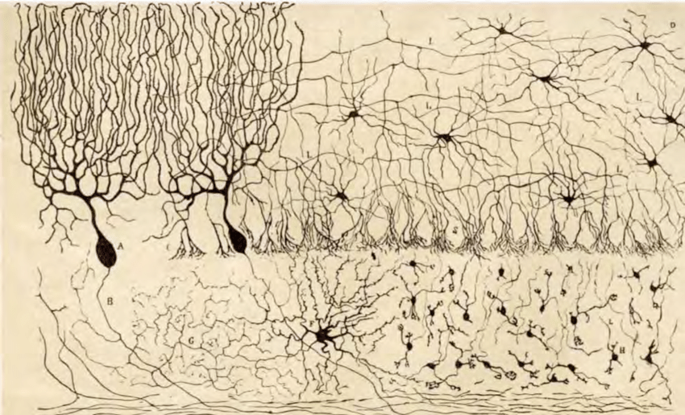
The Neuron Doctrine - Santiago Ramon y Cajal
Chick
Cerebellum
Golgi Stain
Nobel: 1906

Slide 9
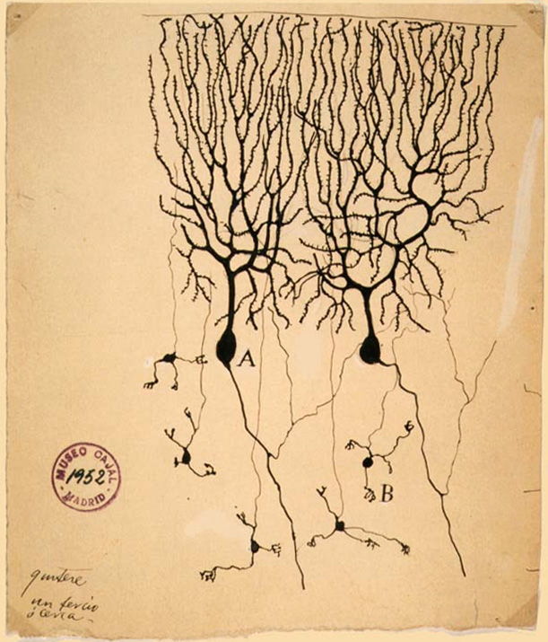
Neurons are polarized
Notes:
Further work by Cajal, many inputs one output

Slide 10

McCullochs - Pitts
1943: Also,
Inhibitory input of strength \infty
Notes:
Can recognize *any* pattern. A network can implement *any* input output function. Can do anything that a turing machine 1937 can do

Slide 11
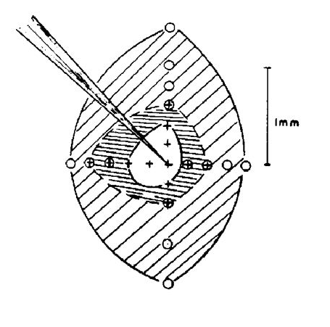
Retinal physiology
1950: Kuffler
Retinal physiology

Slide 12
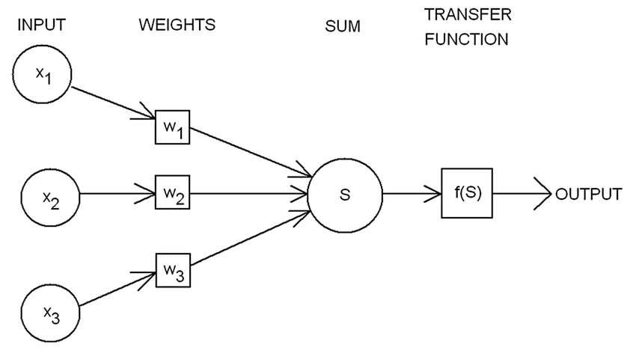
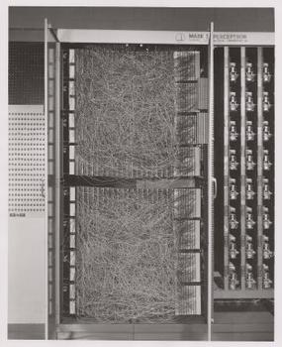
Rosenblatt’s perceptron
Notes:
Arrogant comments: the embryo of an electronic computer that [the Navy] expects will be able to walk, talk, see, write, reproduce itself and be conscious of its existence

Slide 13
With learning
Initialize randomly
If output error positive, lower

Slide 14
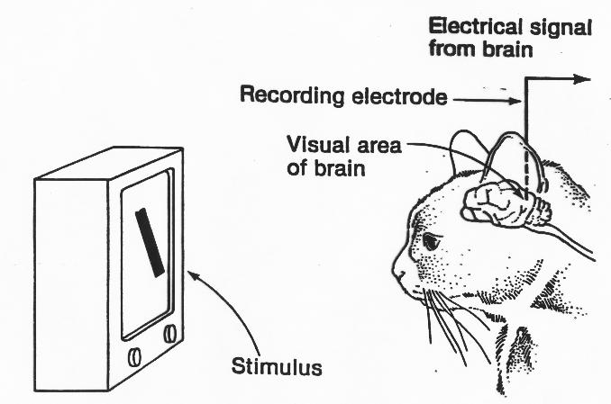
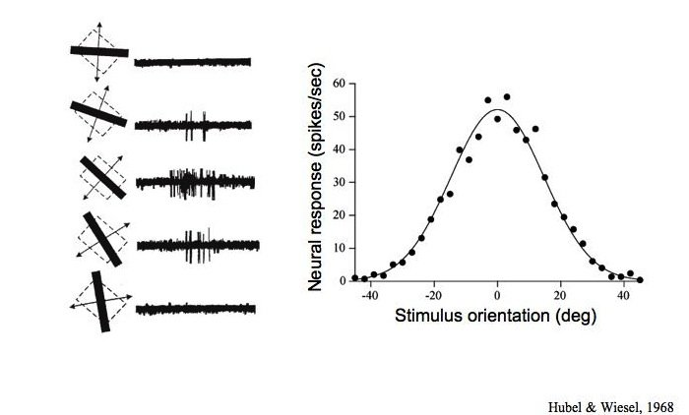
Hubel and Wiesel

Slide 15
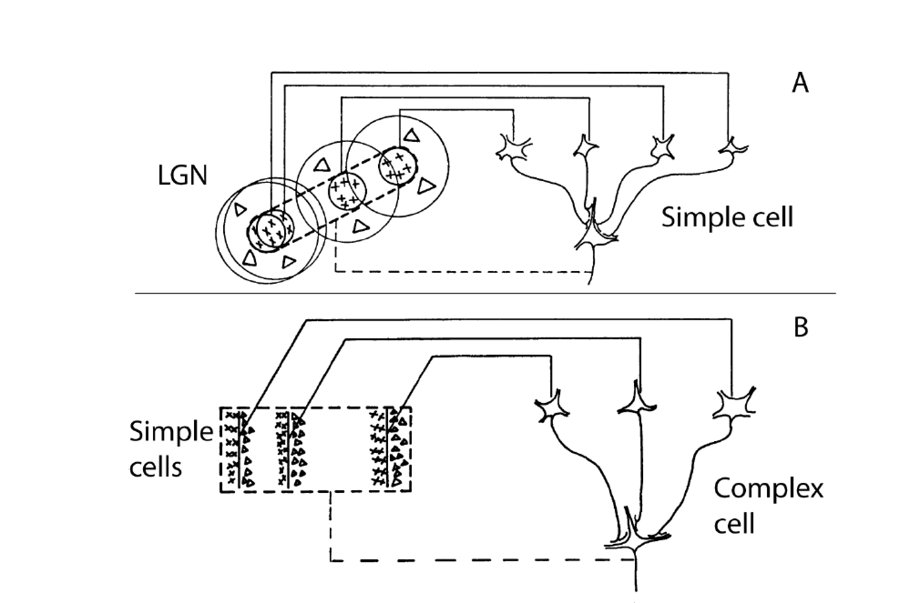
More mapping

Slide 16
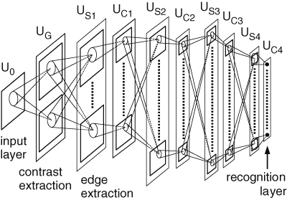
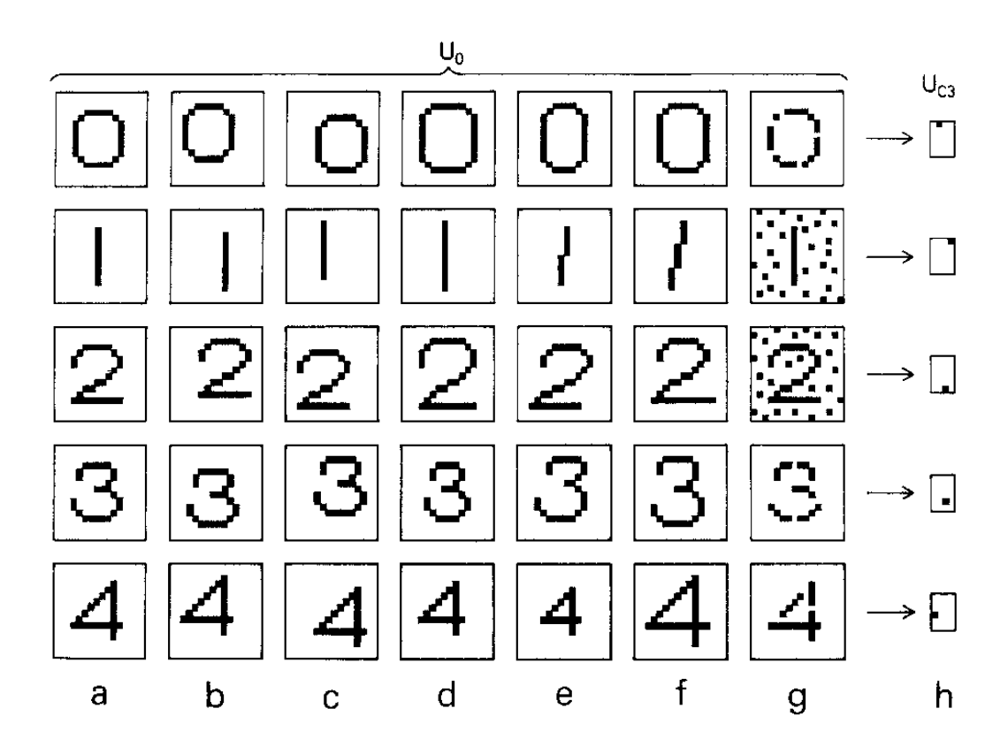
Neocognitron Fukushima
1980

Slide 17
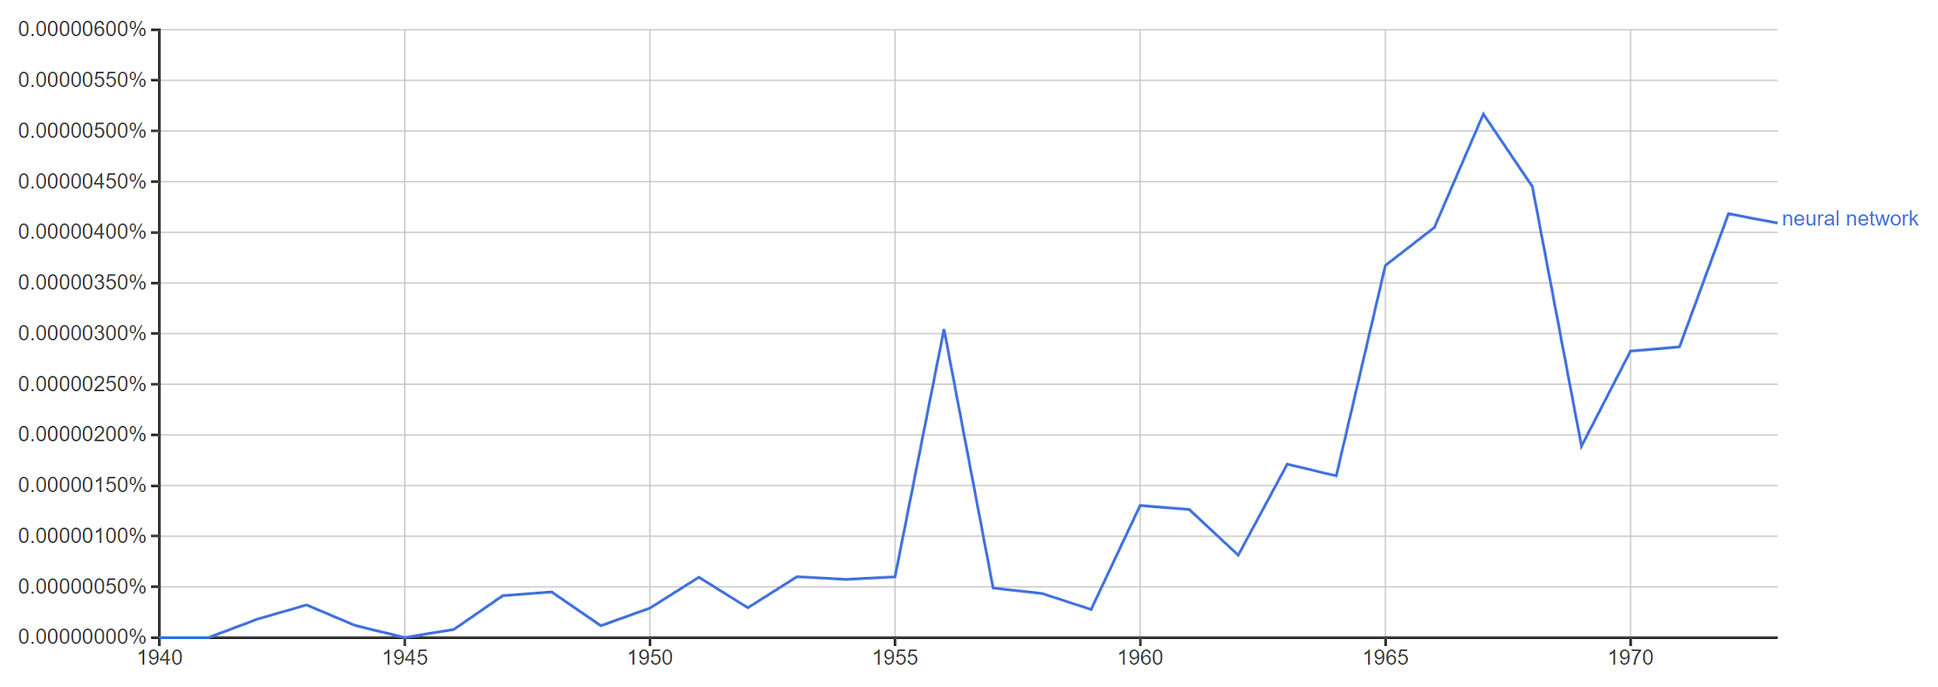
Winter #1
Realization of the xor problem

Slide 18
As of 1970, there was a huge problem with neural nets.
They couldn't solve any problem that wasn't linearly separable.

Slide 19
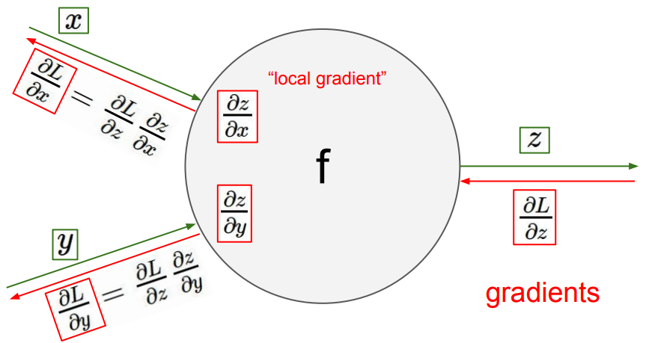
Solution: Backpropagation
Based on the principle of automatic differentiation.
Every float operation performed by a computer at some level involves:
Elementary binary operators (+, - , x, /)
Elementary functions (sin x, cos x, e^x, etc.)

Slide 20
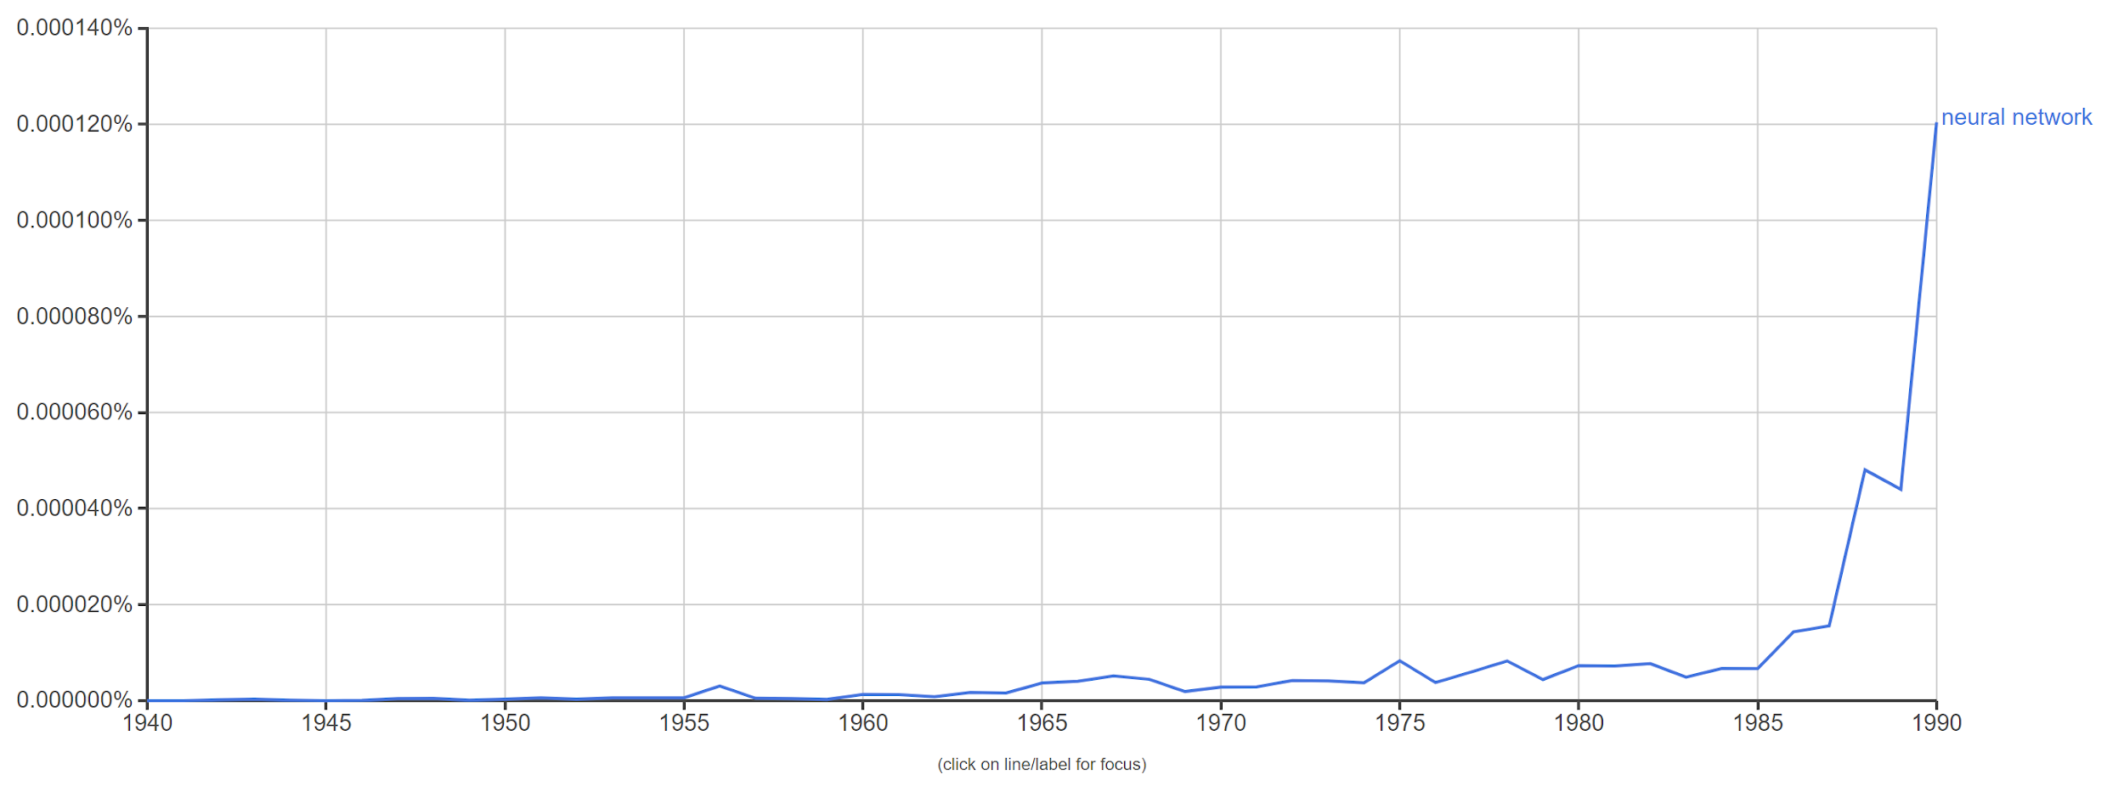
Resurgence of interest in neural net research
Winter #1

Slide 21
As of 1996, there were 2 huge problems with neural nets.
They couldn't solve any problem that wasn't linearly separable.
Solved by backpropagation and depth.
Backpropagation takes forever to converge!
Not enough compute power to run the model
Not enough labeled data to train the neural net

Slide 22
As of 1986, there were 2 huge problems with neural nets.
They couldn't solve any problem that wasn't linearly separable.
Solved by backpropagation and depth.
Backpropagation takes forever to converge!
Not enough compute power to run the model
Not enough labeled data to train the neural net
Outclassed by SVM
Notes:
SVM converges to global optimum in O(n^2) with iterative minimization

Slide 23
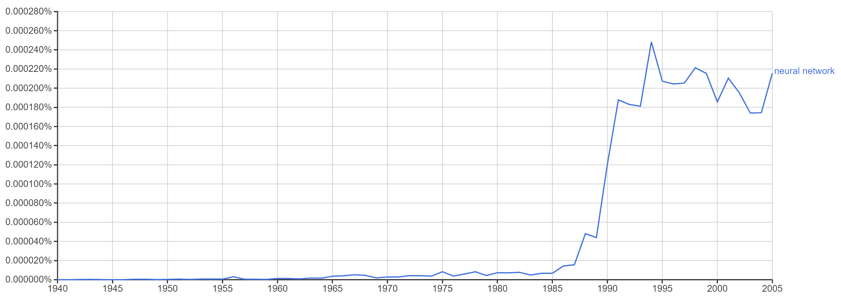
Winter #2

Slide 24
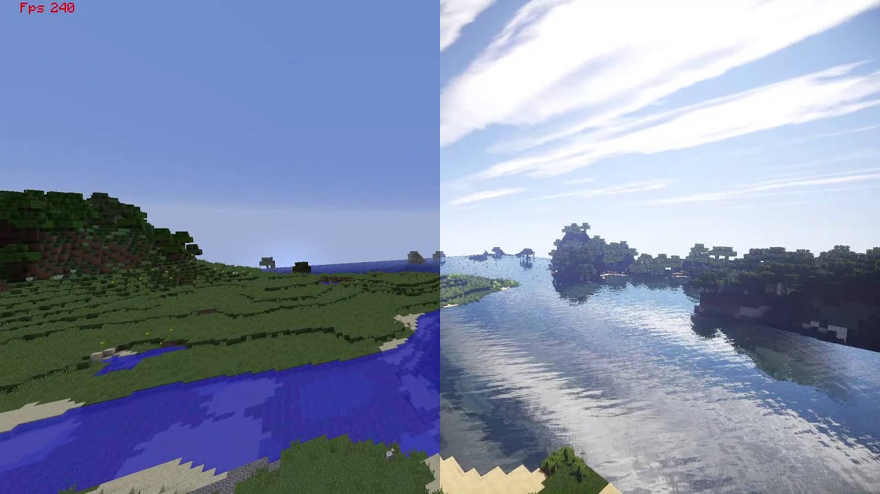
Solution: the GPU

Slide 25
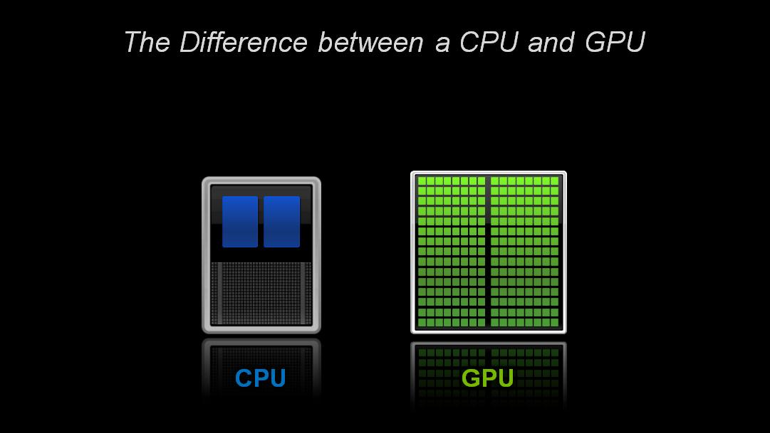

Why are GPUs so good at matrix multiplication?
Much higher bandwidth than CPUs.
Better parallelization.
More register memory.
Notes:
https://www.quora.com/Why-are-GPUs-well-suited-to-deep-learning
https://www.analyticsvidhya.com/blog/2017/05/gpus-necessary-for-deep-learning/

Slide 26
As of 2007, there was one huge problem with neural nets.
They couldn't solve any problem that wasn't linearly separable.
Solved by backpropagation and depth.
Backpropagation takes forever to converge!
Not enough compute power to run the model
Solved by GPU
Not enough labeled data to train the neural net

Slide 27
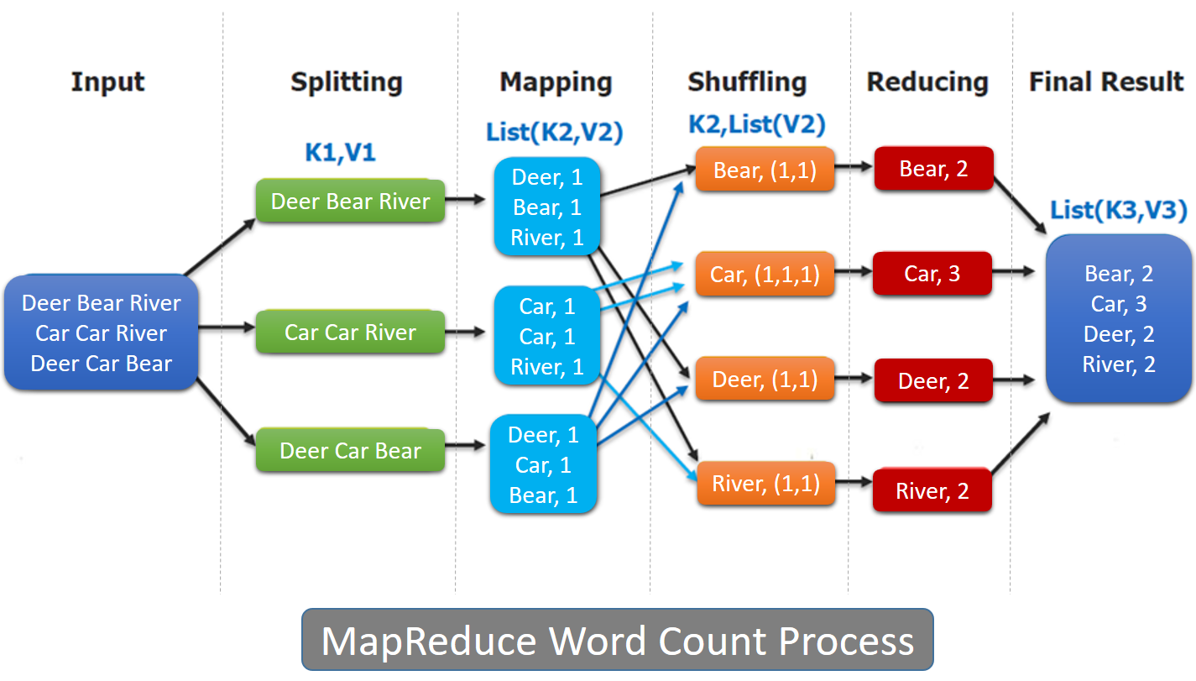
Big Data
2004: Google develops MapReduce
2011: Apache releases Hadoop
2012: Apache and Berkeley develop Spark

Slide 28
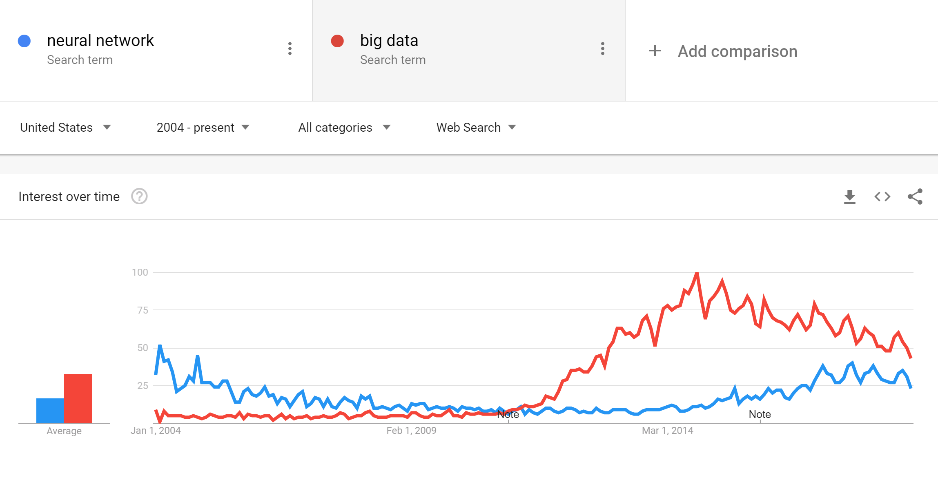
Return of the neural net

Slide 29
The 2010s are the decade of domain applications
They couldn't solve any problem that wasn't linearly separable.
Backpropagation takes forever to converge!
Images are too high dimensional!
Variable-length problems cause gradient problems!
Data is rarely labeled!
Neural nets are uninterpretable!

Slide 30
The 2010s are the decade of domain applications
They couldn't solve any problem that wasn't linearly separable.
Backpropagation takes forever to converge!
Images are too high dimensional!
Convolutions reduce the number of learned weights via a prior.
Encoders learn better representations of data.
Variable-length problems cause gradient problems!
Solved by the forget-gate.
Data is rarely labeled!
Addressed by DQN, SOMs.
Neural nets are uninterpretable!
Addressed by attention.

Slide 31
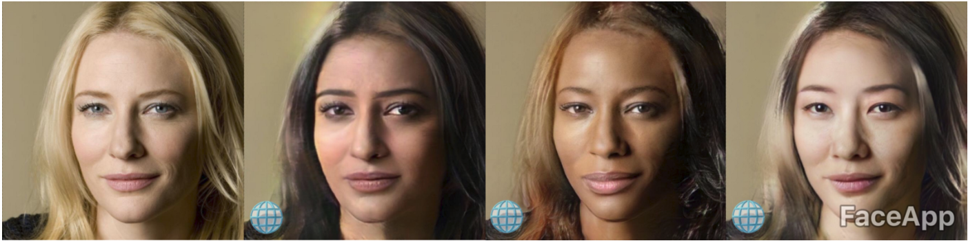

Slide 32
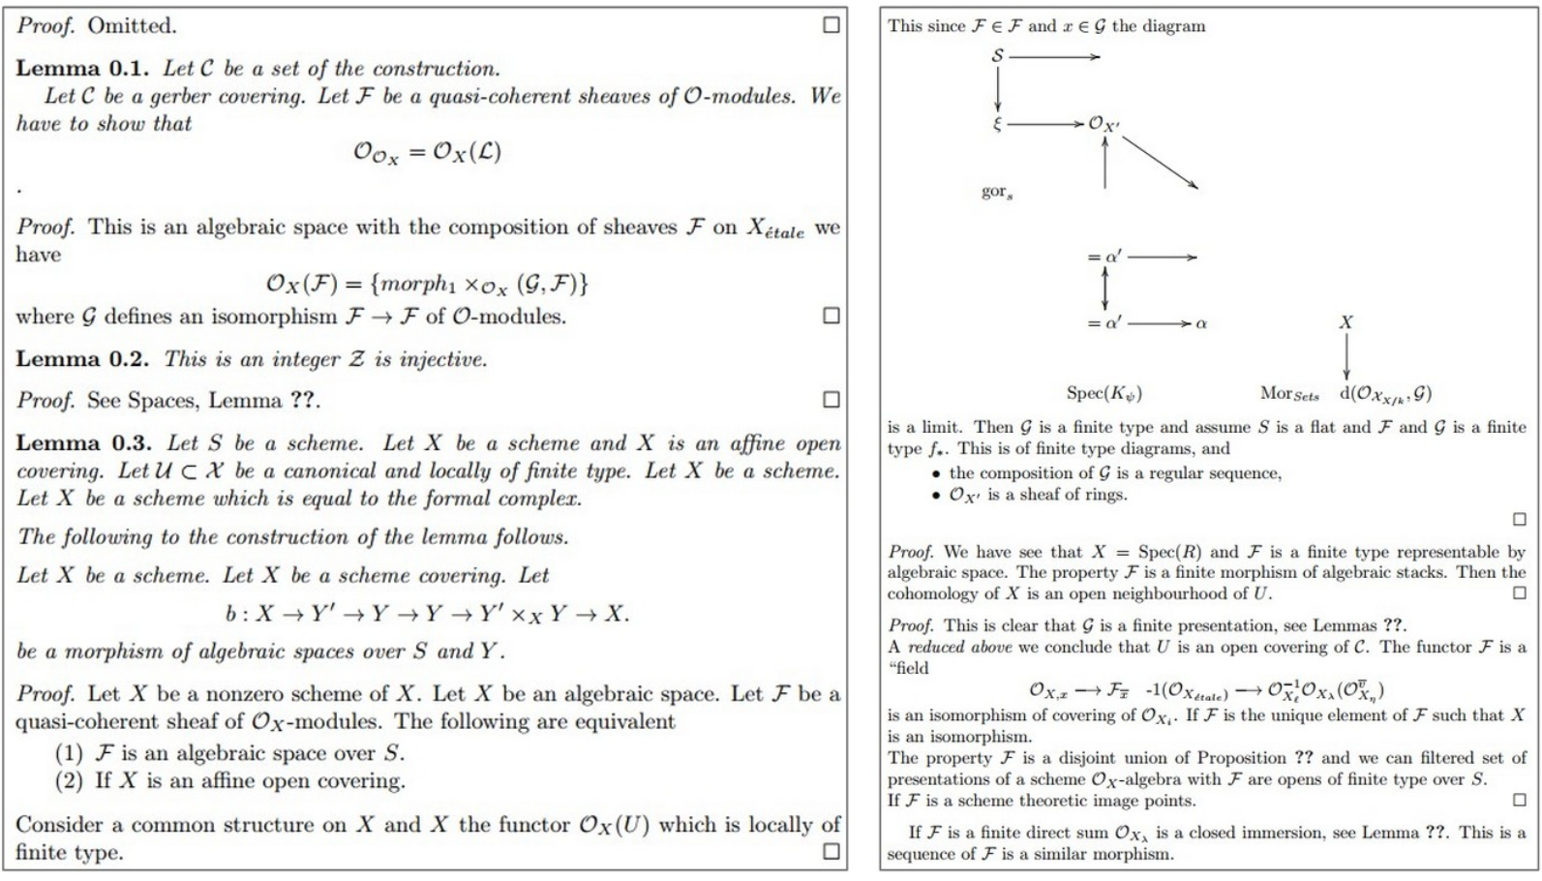

Slide 33
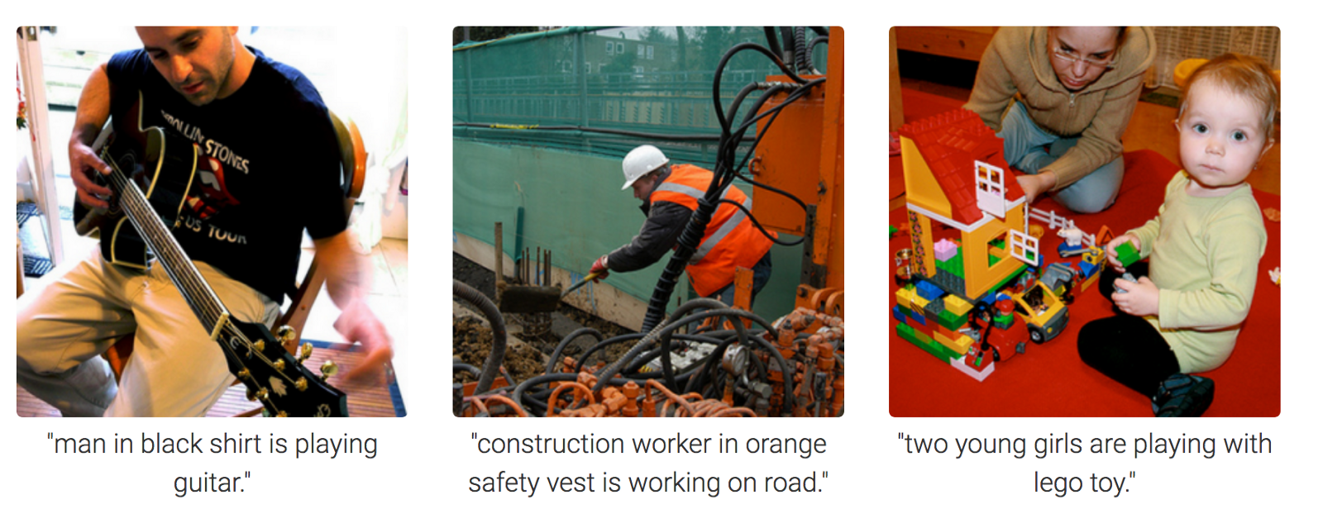

Slide 34
More open problems
Extrapolates poorly when the dataset is too specialized
Can't transfer between domains easily
Can't be audited easily
Still too data-hungry
And many, many more.

Slide 35
"There is almost as much BS being written about a purported impending AI winter as there is around a purported impending AGI explosion." -- Yann Lecun, FAIR

Slide 36
Looking forward
No class on Monday (MLK day)
On Wednesday: Introduction to PyTorch
HW 0: due on 1/30

